Slide 1
CLOUD DEVELOPMENT WORKSHOP
Kevin E Ford
Mobile Practice Lead
Magenic Technologies

Slide 2
What you need today
Machine with VS 2015 installed including Xamarin Componets
GitHub account
Azure Subscription
Visual Studio Mobile Center
Access to https://github.com/Bowman74/CloudDevelopmentWorkshop

Slide 3
Today’s Workshop
iOS App
Android App
UWP App
Xamarin Forms
Azure
Mobile Center
Build
Document DB
App Service
Azure AD
Distribute
Crash
Analytics
Notes:
Quick app demo

Slide 4
Azure Offerings
Mobile Center

Slide 5
Types of Cloud Offerings
IAAS
PAAS
SAAS

Slide 6
The Azure Portal
Https://portal.azure.com
Replaces old https://manage.windowsazure.com/ site
Blade based
Configurable Dashboard

Slide 7
Demo: Examining the Azure Portal

Slide 8
Notes:
Web Apps – Backends for Websites
Mobile Apps – Backends for mobiel applications
API Apps – General purpose APIs
Logic Apps – Business Processes

Slide 9
Web Apps
Create websites and APIs
WordPress, Umbraco, Joomla, and Drupal
Azure AD Integration
.Net, Node.js, PHP
Global Scalable, Dev Ops, Configurations

Slide 10
Mobile Apps
Azure AD Integration, other providers – Server Flow
On line / off line data sync
Push Notifications
Create APIs
Global Scalable, Dev Ops, Configurations

Slide 11
API Apps
Create APIs, .NET, PHP, Node.js, Java, or Python
Azure Active Directory, social network single sign-on, or OAuth
Global Scalable, Dev Ops, Configurations
Insights

Slide 12
Logic Apps
Visual workflow / process designer
EAI, B2B/EDI, and business processes
Integrate with SaaS and enterprise applications

Slide 13
Demo: Looking at Azure Mobile Apps

Slide 14
Azure AD

Slide 15
Azure AD Features
Single sign on
Self Service
Integrate with Local AD
Tie into other Offerings (Office 365, Yammer, Teams, etc)
One per Azure directory
Notes:
99.9 SLA

Slide 16
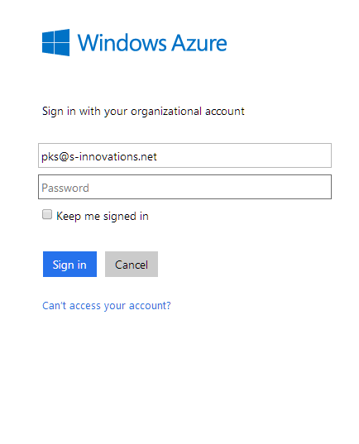
Authentication Flow For Today’s App
Azure Mobile App
Azure AD
Redirect
Zumo Token
Token
Request
Client
Token Store
Credentials

Slide 17
Demo: Looking at Azure AD

Slide 18
Visual Studio Mobile Center

Slide 19

Visual Studio Mobile Center – Build Features
Tie to Github (BitBucket, VSTS coming)
Build vendor native iO (Swift/Obj-C), Xamarin, ReactNavite (Soon Windows)
Based on branch
Signs APKs and IPAs
Push to deployment

Slide 20

Visual Studio Mobile Center – Test Features
Run Tests on multiple devices
Test Frameworks – Appium, Calabash, Expresso, Xamarin UITest
Currently only run via command line

Slide 21

Visual Studio Mobile Center – Deploy Features
Multiple Groups allowed
Version notification via email
Group invite e-mail
Builds only go to one group

Slide 22


Visual Studio Mobile Center – Crash and Analytics
Basic crash reporting
Information on user devices and versions
Some events recorded automatically
Can define custom events

Slide 23
Visual Studio Mobile Center – First Impressions
Very basic functionality, builds have little customization
Much still seems missing (Cordova, UWP)
Interesting what they did first
Security and tables redundant to other Azure offerings
Lots of potential

Slide 24
Demo: Looking at Visual Studio Mobile Center

Slide 25
Demo: Setting up Azure AD and Tying it to a Mobile App

Slide 26
Hands on Lab: Setting up Azure AD and Tying it to a Mobile App (10:00-10:45)

Slide 27
Demo: Writing a mobile login page to work against Azure App Service/Azure AD

Slide 28
Hands on Lab: Writing a mobile login page to work against Azure App Service/Azure AD (11:15-12:00)

Slide 29
Demo: Setting up Doc DB and writing an Azure App API

Slide 30
Hands on Lab : Setting up Doc DB and writing an Azure App API (12:15-1:00)

